Slide 1


Gig Economy Application
Seamlessly connecting job seekers and employers in the dynamic gig economy. Our cutting-edge mobile app is revolutionizing the way people find and manage short-term work opportunities.
Presented by : Group 9
Ramya Sree Vudugu
Pallavi Padam
Paavani Janapareddy

Slide 2
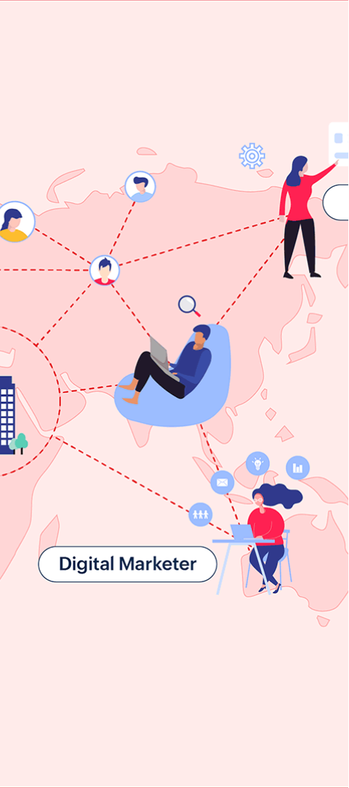
The Rise of the Gig Economy
1
Flexible Work Arrangements
2
Accessible Opportunities
Providing a platform for people to easily find and apply for a diverse range of gig jobs.
Empowering individuals to take control of their careers and work on their own terms.
3
Adaptable Workforce
Enabling businesses to quickly scale their teams and access specialized talent as needed.

Slide 3
Tackling the Challenges
Pain Points for Workers
Struggles for Employers
Our Solution
Difficulty finding reliable gig work and managing multiple short-term jobs.
Inefficient hiring processes and lack of visibility into the available talent pool.
Providing a centralized platform to seamlessly connect job seekers and employers.

Slide 4
Unleashing the Power of Our App
Task Posting
Job Browsing
Employers can easily list gig opportunities with detailed job requirements.
Job seekers can explore a wide range of available gig jobs and apply in just a few taps.
Real-Time Messaging
Notifications
Candidates and employers can communicate directly within the app to discuss job details and coordinate schedules.
Users receive instant updates on new job postings, application status, and important messages.

Slide 5

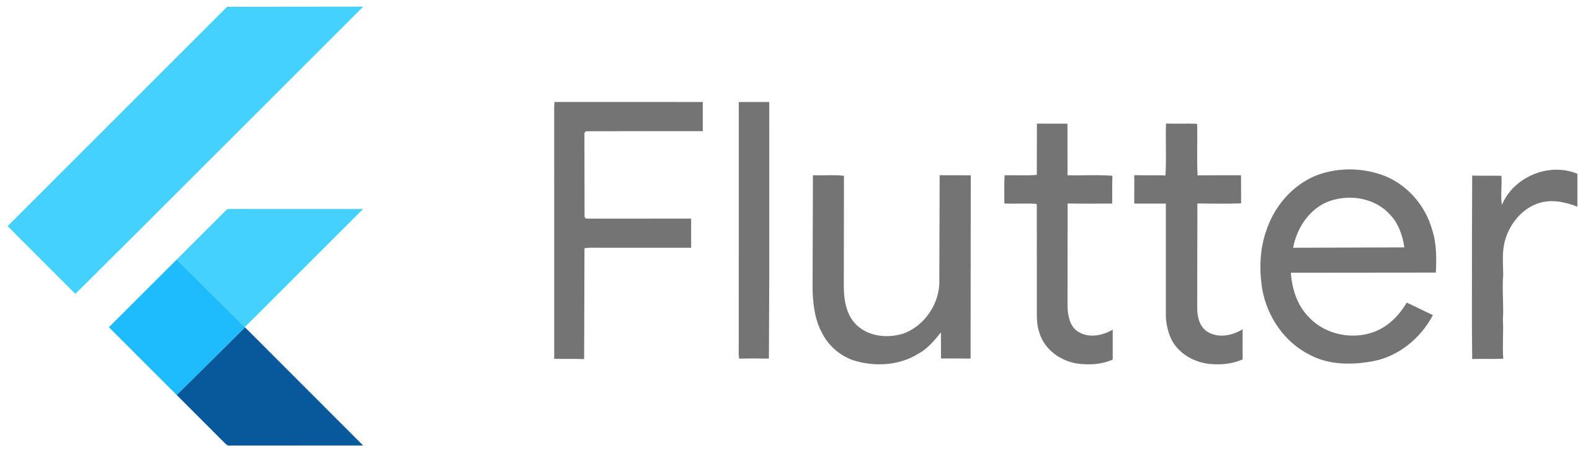
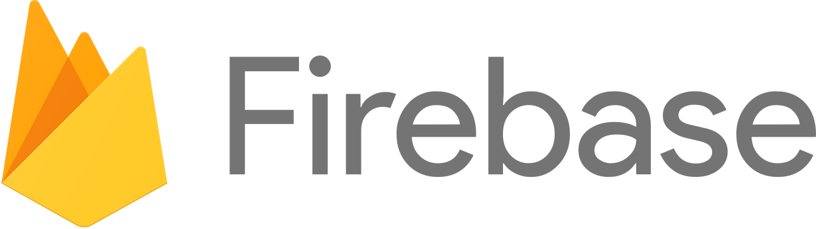
Cutting-Edge Technology Stack
Flutter
Firebase
Cloud-Powered
Cross-platform mobile app development framework for building high-performance, visually stunning interfaces.
Comprehensive app development platform, providing user authentication, real-time database, and cloud functions.
Leveraging the scalability and reliability of cloud infrastructure to ensure a seamless user experience.

Slide 6
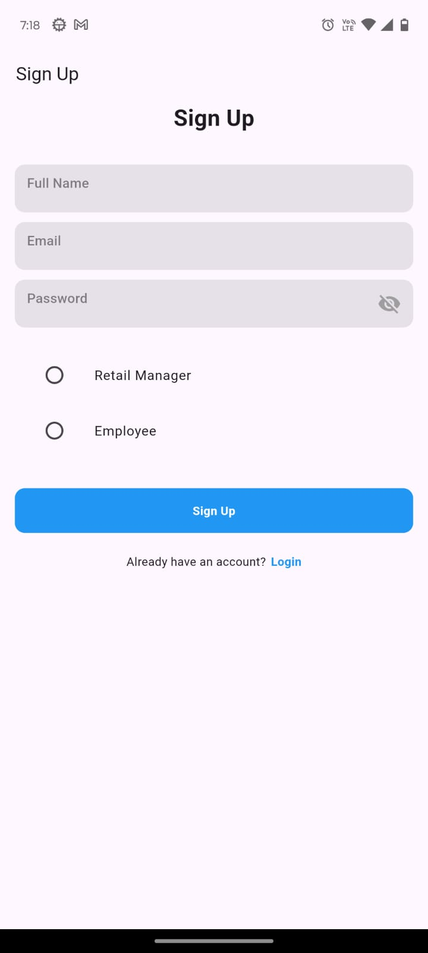



Secure User Registration
Sign Up
Users can easily create an account by providing their personal details and selecting their role (job seeker or employer).
Authentication
Firebase Authentication ensures secure login and access to the app's features.
Profile Setup
Users can customize their profiles, including skills, work history, and preferred job categories.

Slide 7

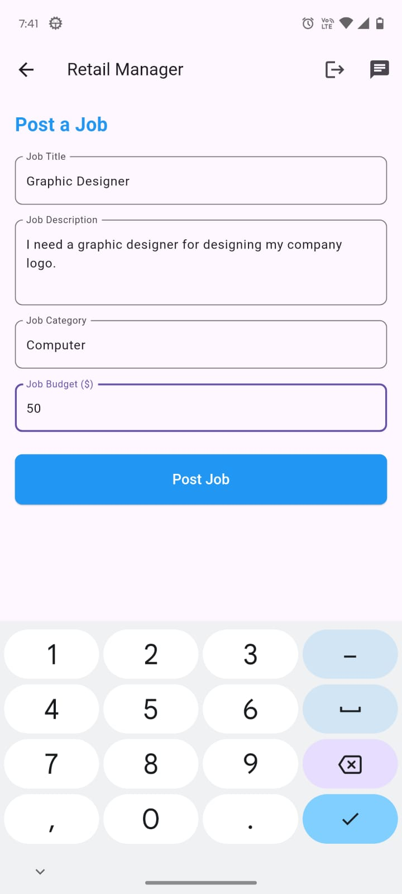
Streamlined Task Posting and Browsing
1
Post a Task
Employers can create detailed gig job listings, including job description, required skills, and compensation details.
2
Browse Opportunities
Job seekers can easily search and filter through the available gig jobs, reading through the details and applying for the ones that match their qualifications.
3
Candidate Selection
Employers can review applicant profiles, communicate directly with candidates, and hire the best fit for the job.

Slide 8

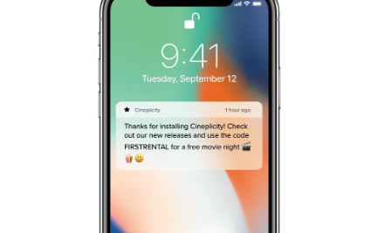
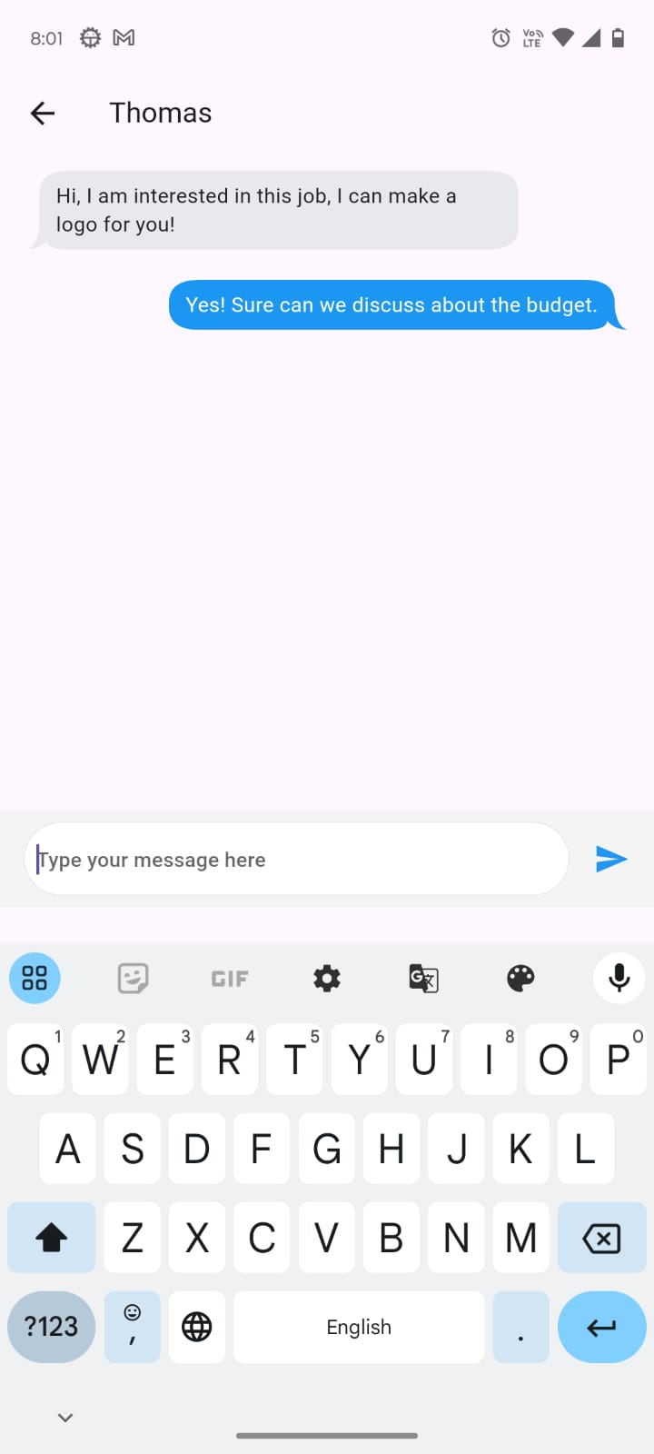
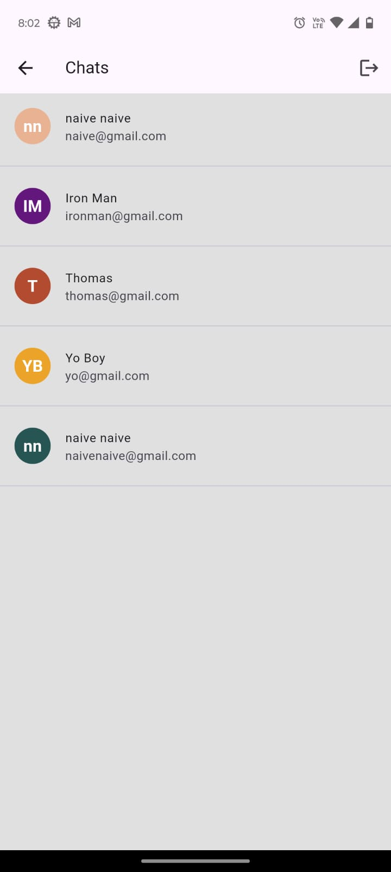
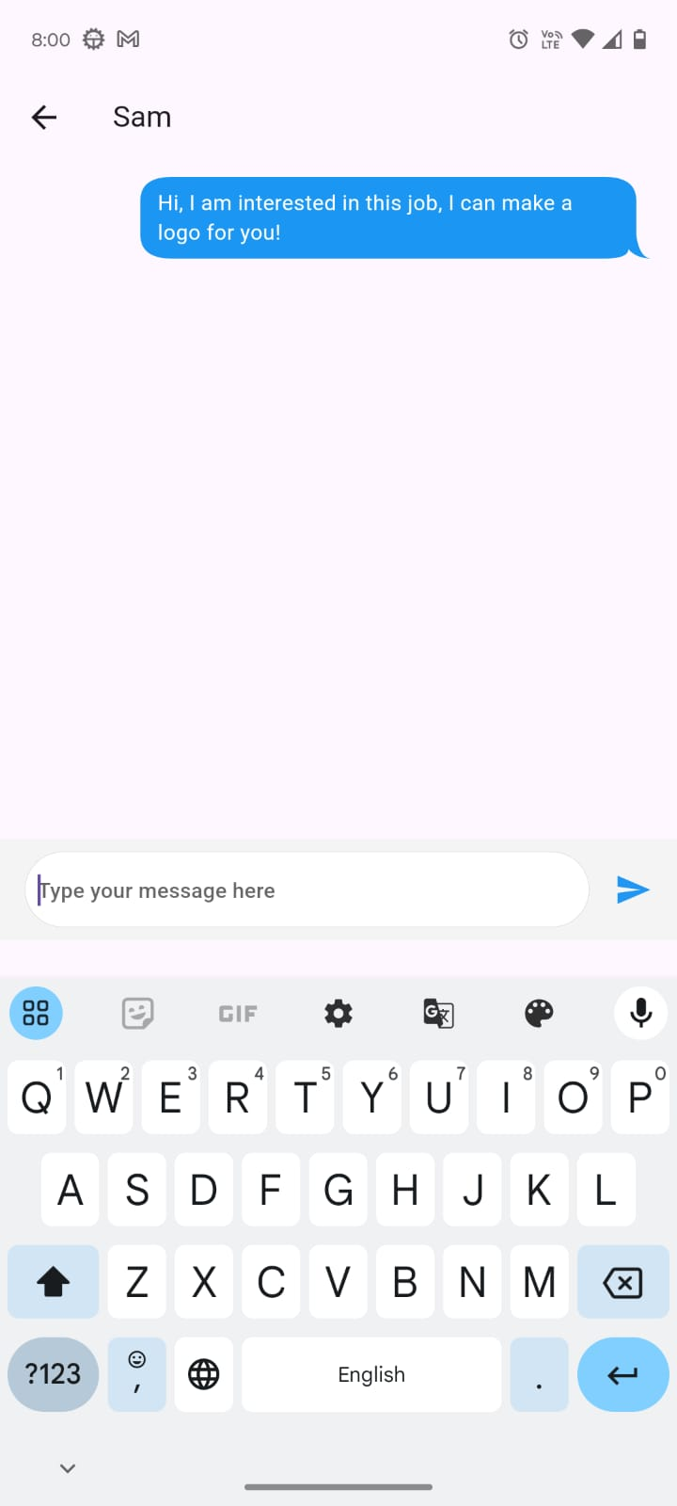
Seamless In-App Communication
Increased Productivity
Streamlined communication and instant updates help users stay on top of their gig work opportunities.
Instant Messaging
Users can chat directly with each other to discuss job details, coordinate schedules, and provide updates.

Slide 9
The Future of Gig Work
Flexible Work Arrangements
Empowering individuals to take control of their careers and work on their own terms.
Accessible Opportunities
Providing a platform for people to easily find and apply for a diverse range of gig jobs.
Adaptable Workforce
Enabling businesses to quickly scale their teams and access specialized talent as needed.

Slide 10
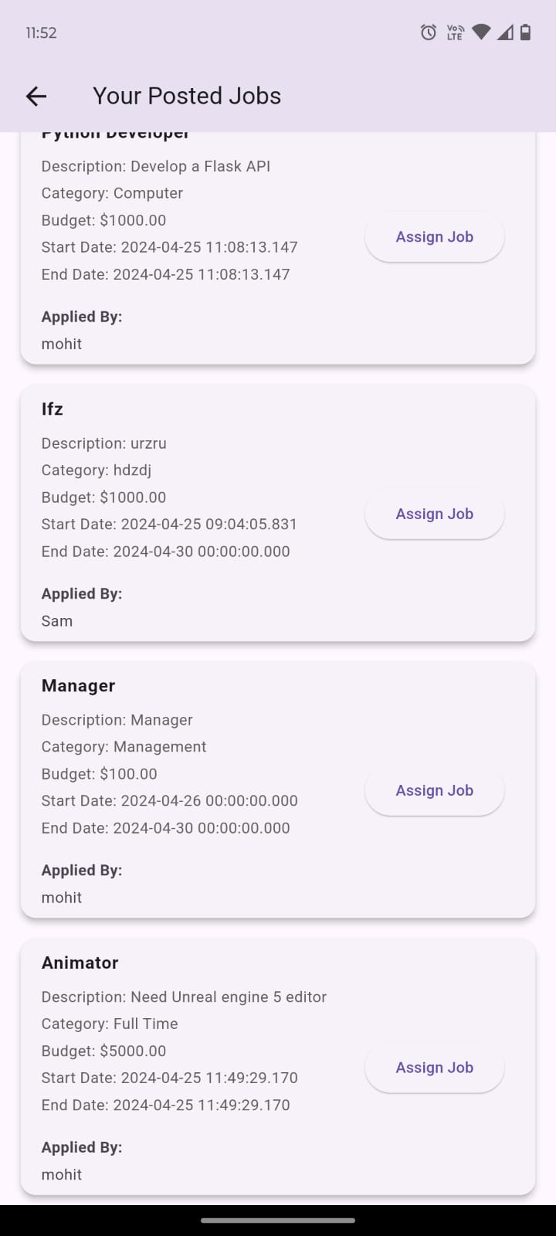
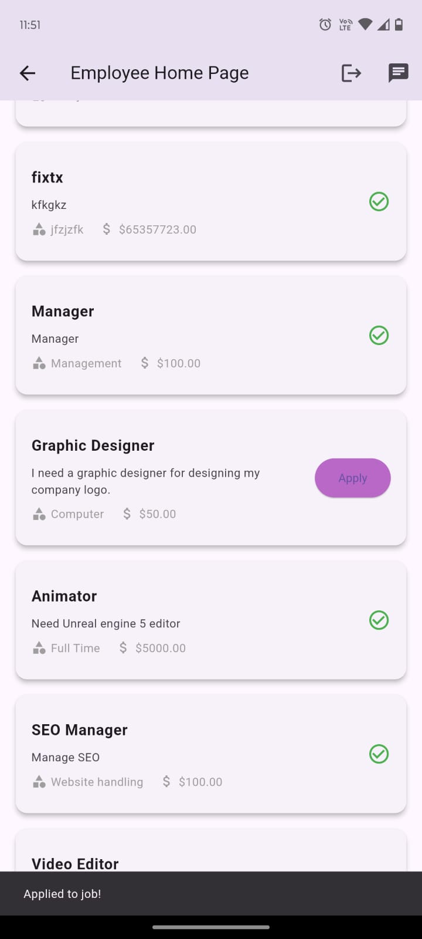
User Profiles
Employee’s Dashboard
Manager’s Dashboard
Comprehensive Profiles
There are two user profiles that our app offers, one is the Retail Manager, the one who posts and accepts job requests, and the other one is employee.
Task Management
Gig workers can easily track and manage their assigned tasks and applications, staying organized and in control of their workflow.
Python Developer’s Job applied by the Employee

Slide 11
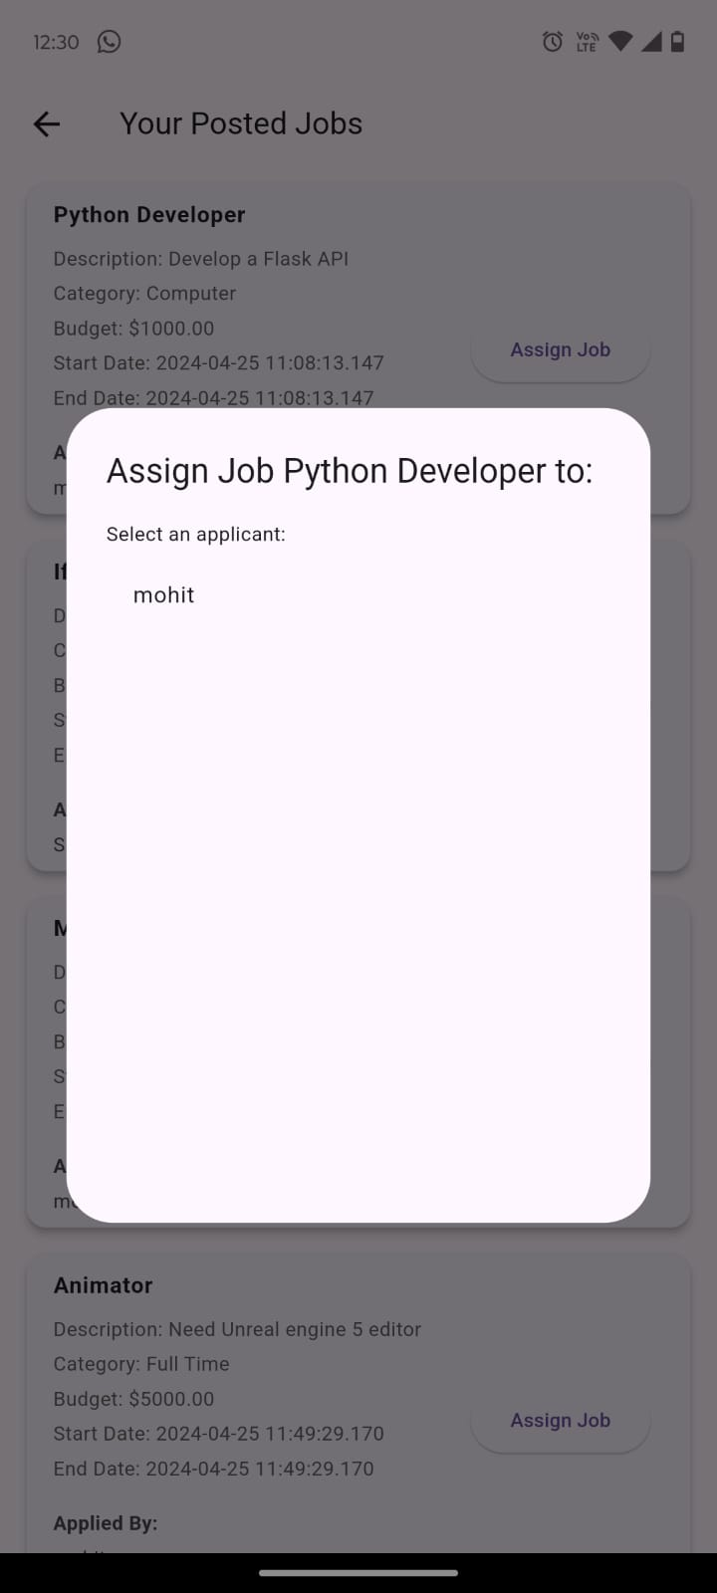
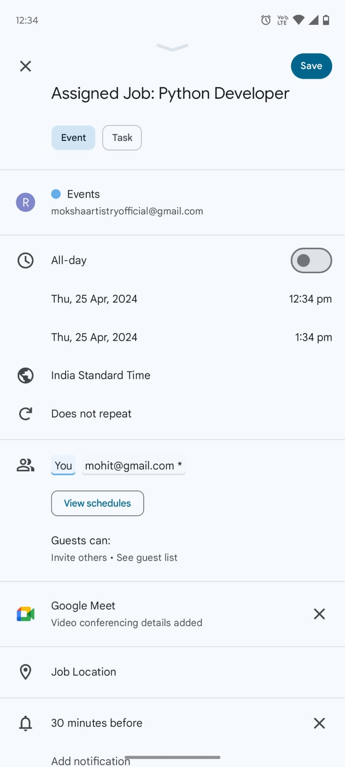
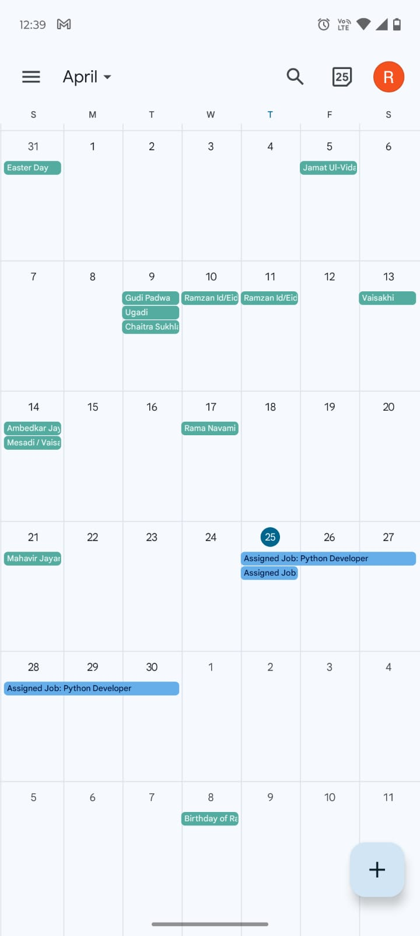
Job Assigning Workflow
Manager sees the users who
have applied for the job, and
decides whom to assign the
job after chatting with him on
the app.
As soon as he assigns a job,
a google calendar event is
made from his device and
its email invite is sent to
the job applier.

Slide 12
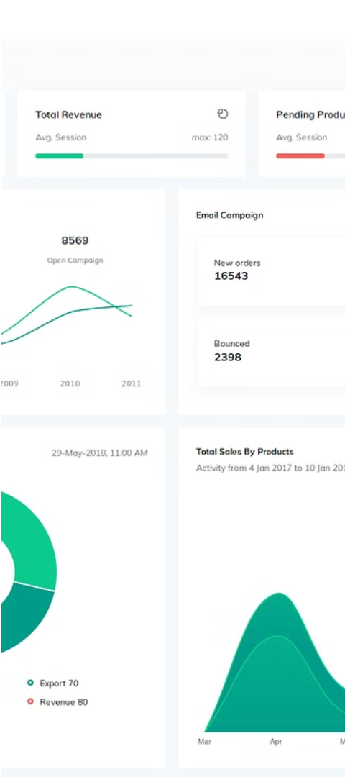
Admin Panel
Activity Monitoring
Task Moderation
The admin panel provides comprehensive visibility into user activity, enabling you to track engagement, identify trends, and make informed decisions.
Efficiently handle reported tasks and user queries, ensuring the integrity and safety of our platform for all participants.
User Support
Dedicated support channels and tools empower admins to address user concerns and provide a superior customer experience.

Slide 13



Scalability Considerations
Robust Infrastructure
Our platform is designed with scalability in mind, leveraging cloud-based technologies and distributed systems to accommodate growing user demands.
Flexible Architecture
Modular and adaptable architecture allows us to seamlessly scale features, services, and data storage to meet the evolving needs of our users.
Continuous Optimization
Ongoing performance monitoring and optimization ensure that our platform maintains optimal speed, reliability, and responsiveness as it scales.

Slide 14
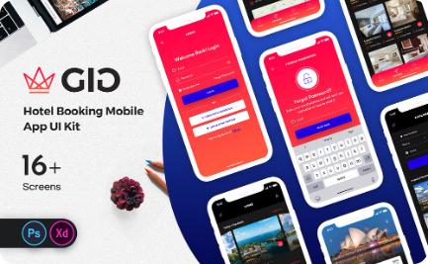

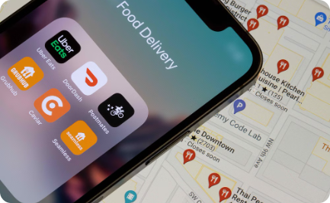
Intuitive Design
Seamless Navigation
Streamlined Workflows
Personalized Experience
Our user-centric design prioritizes intuitive navigation, making it easy for gig workers and employers to find what they need, when they need it.
Streamlined task posting, application, and communication features enhance productivity and efficiency, enabling users to focus on their work.
Customizable profiles and personalized recommendations ensure that each user's experience is tailored to their unique needs and preferences.

Slide 15
Live Demonstration
Task Posting
1
Employers can easily create and post their gig opportunities, leveraging our intuitive interface to clearly define requirements and budgets.
2
Browsing and Applying
Gig workers can explore available tasks, review details, and submit their applications seamlessly, showcasing their skills and experience.
Secure Communication
3
Our in-app messaging and collaboration tools enable employers and gig workers to connect, coordinate, and complete tasks efficiently and effectively.

Slide 16
Benefits to Users
1
Flexible Work Opportunities
2
Streamlined Hiring Process
Empower gig workers to take control of their schedules and earn on their own terms.
Simplify the task posting and hiring process for employers, connecting them with the right talent efficiently.
3
Enhanced Transparency
4
Scalable Solutions
Provide both parties with visibility into the gig economy, fostering trust and collaboration.
Offer a platform that can adapt and grow alongside the evolving needs of the on-demand workforce.

Slide 17



Driving the Future of Work
Innovation
Community
Growth
Our platform harnesses the power of technology to revolutionize the way people find and manage flexible work opportunities.
By empowering gig workers and employers to connect and collaborate, we're building a thriving ecosystem of on-demand talent.
Our scalable and adaptable solutions are designed to accommodate the ever-expanding gig economy, ensuring long-term success.

